Slide 1
Module 6: Lesson 4 Data Lake Pattern

Slide 2
Legacy Enterprise Data Organization Data Warehouse
A data warehouse is a repository (usually a relational database) that focuses on storing and managing highly structured data from various sources
Data warehouses establish a pre-defined schema (schema-on-write) that dictates how data it manages is stored and access
Schema-on-write enforces a predefined schema before data is written that mandates data conform to a specific structure and data types
This imposed structure enables pre-built queries and efficient retrieval of data subsets, optimizing performance for well-defined analytical tasks

Slide 3
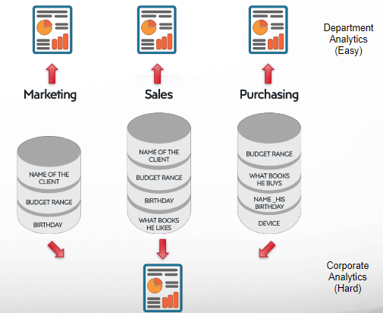
Legacy Enterprise Data Organization Data is Maintained Across Isolated Data Silos
A data silo refers to a situation where different subsets of information are stored and managed independently by separate systems
Data is not easily accessible or shareable across an organization, hindering collaboration and creating challenges for achieving a unified view of information.

Slide 4
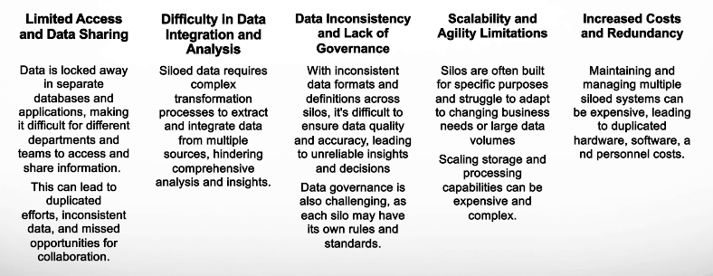
Legacy Enterprise Data Organization Challenges

Slide 5
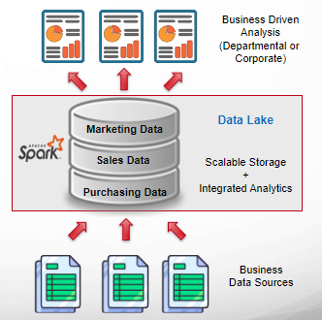
Modern Enterprise Data Organization Data Lake
Data lakes present a compelling alternative to the restrictive landscape of data silos, offering a dynamic and flexible approach to information management
Unified Repository | Schema Flexibility
Unlike siloed systems, data lakes serve as centralized reservoirs, consolidating diverse data formats (structured, unstructured, multimedia) in their native state. This eliminates the need for duplicated data storage and fosters cross-departmental access | Unlike rigid silo structures, data lakes embrace a schema-on-read approach. Data is ingested without imposing strict schemas, allowing for flexible exploration, ad-hoc queries, and the seamless integration of new data types as research or business needs evolve

Slide 6
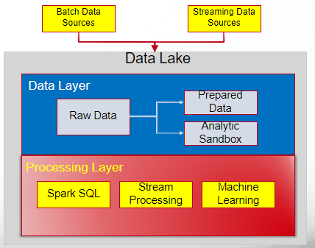
Data Lake Initial Vision
“If you think of a [data warehouse] as a store of bottled water – cleansed and packaged and structured for easy consumption – the data lake is
a large body of water in a more natural state.
The contents of the data lake stream in from a source to fill the lake, and various users of the lake can come to examine, dive in, or take samples.”
James Dixon, CTO, Pentaho (2010)

Slide 7
Data Lake Architecture
A
data lake
is the combination of
(1)
A scalable repository that allows storage of massive volumes of both structured and unstructured data
(2)
An integrated big data processing capability able transform and analyze this data

Slide 8
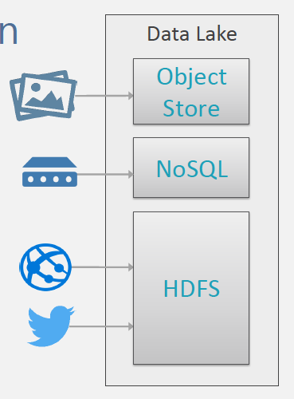
Data Lake Storage Options
A data lake is a conceptual idea. It can be implemented with one or more technologies.
HDFS is a very common option for data lake storage. However, Hadoop is not a requirement for a data lake.
NoSQL databases are also very common as they support schema-on-read semantics and unstructured data
Similarly object stores (like Amazon S3 or Azure Blob Storage) can also be used

Slide 9
Data Lake Storage Options
Data lakes are were originally based on Hadoop systems
In deployments based on Hadoop, data is loaded into HDFS and resides on the different computer nodes of a Hadoop cluster for scalability
MapReduce, Spark and other data Hadoop processing technologies were then used to manipulate the data
Increasingly, though, data lake stores are being built on cloud object storage services instead of (or in addition to) Hadoop HDFS
But the cloud object stores are usually completed integrated with Hadoop or Spark data processing to create the overall data lake architecture

Slide 10
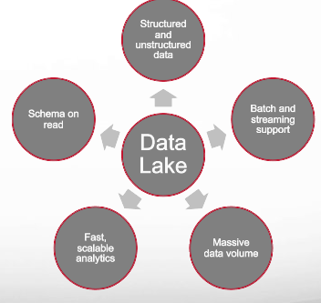
Data Lake Benefits
All data in one place
Scale to massive volumes of data
Ingest all types of data in any format (structured or unstructured)
Manage streaming and batch data in a unified platform
Store streaming data for real-time analysis
Store data for longer periods of time to enable historical analysis
Transform and query data using a variety of methods
Schema on read
Designed for low-cost storage

Slide 11
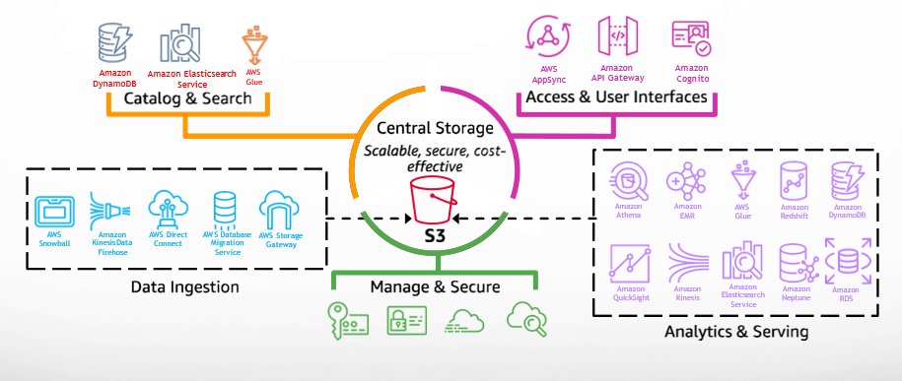
Data Lake on AWS

Slide 12
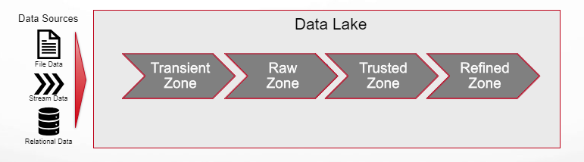
Zoned Data Lake
Refers to a data management concept where data within a data lake is organized into different zones based on its type, usage, and access requirements
Each zone represents a specific area within the data lake that serves a distinct purpose and has different levels of access and processing capabilities

Slide 13
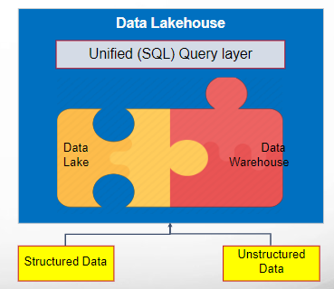
Data Lake Variant Data Lakehouse
Combines scalability and cost-effectiveness of a data lake with structured schema and optimized queries of a data warehouse
Provides a unified repository for diverse data types, from structured relational tables to unstructured logs and multimedia
Unlike traditional data warehouses bound by rigid schemas, the data lakehouse embraces schema flexibility
Distributed schema-on-read queries handle exploration of raw data at scale, while traditional schema-on-write SQL interfaces enable efficient analysis of structured datasets
Example realizations include DataBricks Delta Lake, AWS Redshift Spectrum and Azure Synapse

